Slide 1
Autonomous Car Prototype

Slide 2
Content
Modules - Lane, Vehicle, Traffic Signal
Receiver Operating Characteristic
Core Workload Management
Requirements - Minimum, Target, Optimal

Slide 3
Modules
Lane Detection
Vehicle Detection
Traffic Signal Detection

Slide 4
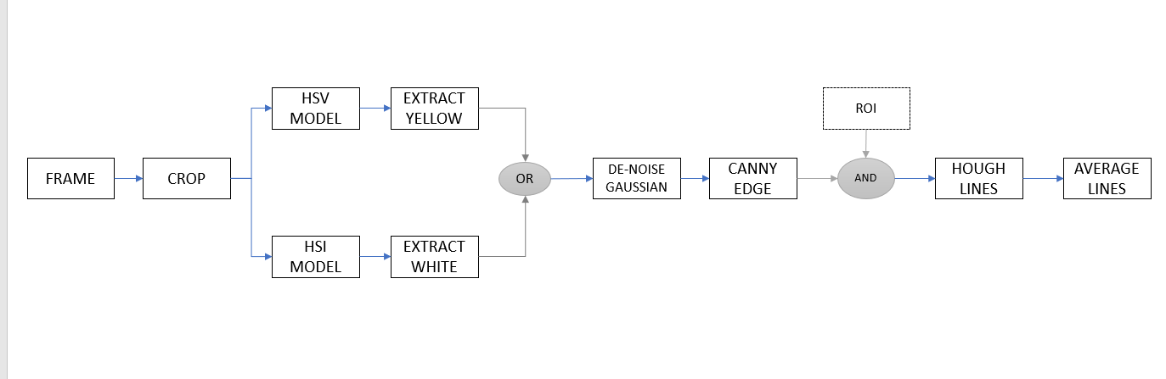
Lane Detection
Block Diagram

Slide 5
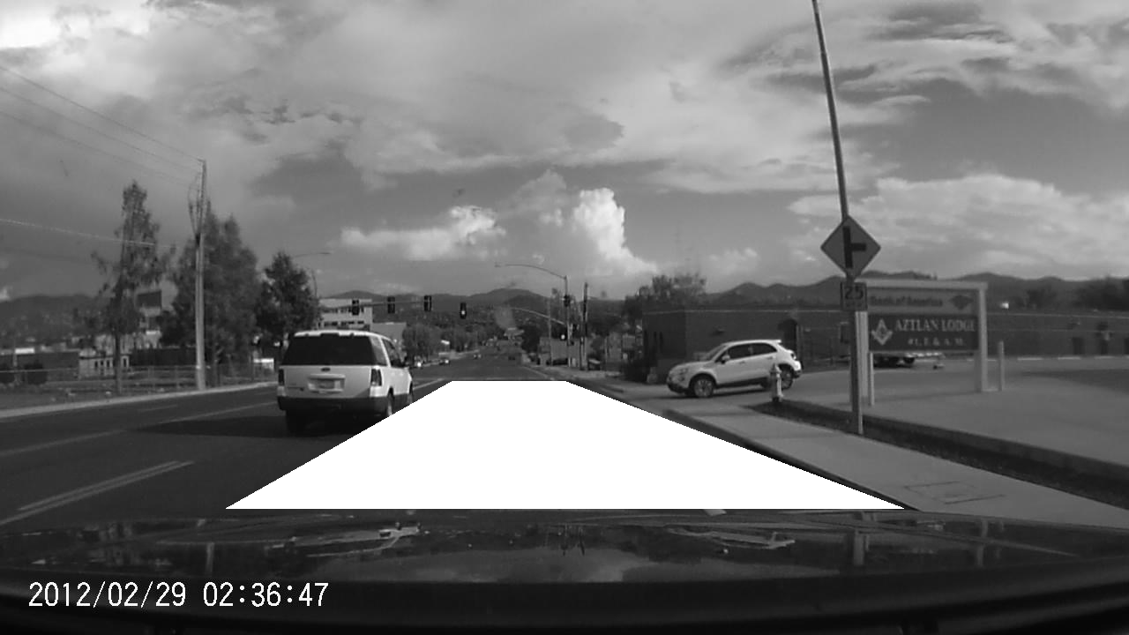
Region of Interest

Slide 6
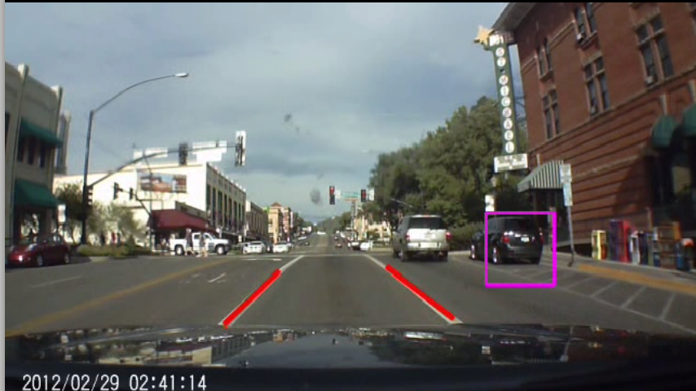
Draw Lines

Slide 7
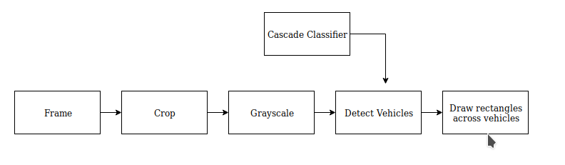
Vehicle Detection

Slide 8
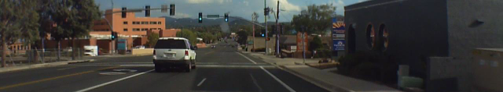
Region Of Interest

Slide 9
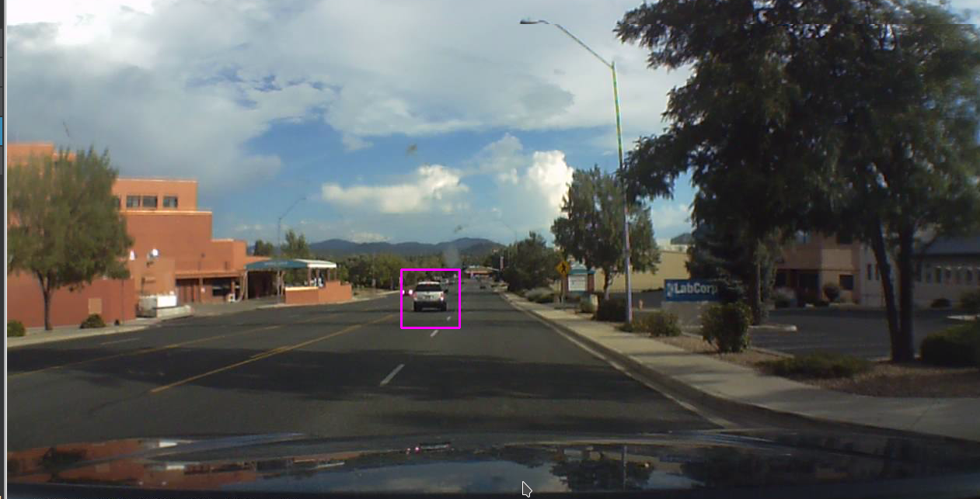
Detect Vehicles

Slide 10
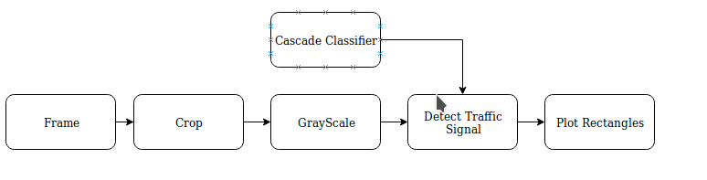
Signal Detection

Slide 11
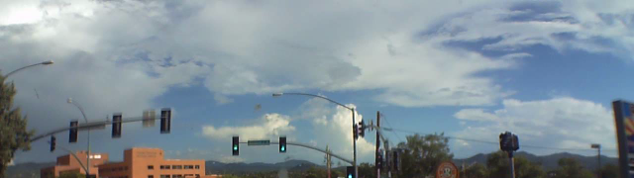
Region of Interest

Slide 12
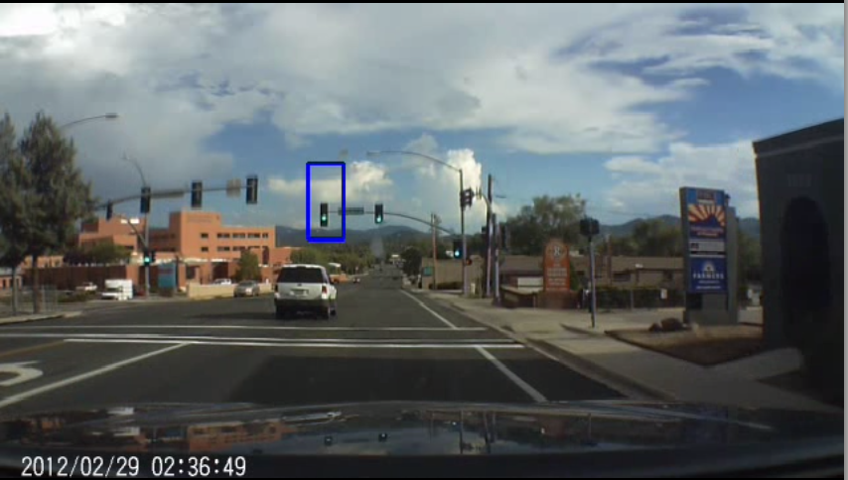

Slide 13
Receiver Operating Characteristic
TPR = (TP/(TP+FN))
FPR = (FP/(FP+TN))
The graph of FPR vs TPR is plotted for ROC
Points above the diagonal (Line at 45 degrees joining point (0,0) (1,1)) are considered to be good classification results.

Slide 14
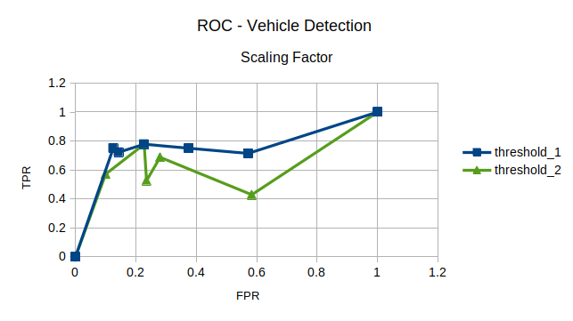
Changing the Scaling Factor of DetectMultiscale
Threshold 1 = 1.2
Threshold 2 = 1.4

Slide 15
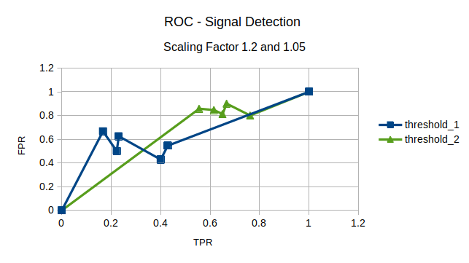
Changing the scaling factor DetectMultiscale

Slide 16
Conclusion
Vehicle ROC
Based on the ROC observations I conclude that the scaling factor for vehicle detection should be 1.2. Even though computation time is more for 1.2 than for 1.4 the accuracy is excellent compared to scaling factor 1.4
Traffic Signal ROC
Based on the ROC observations I conclude that even though at scaling factor 1.05 we are getting a large number of false positive the number of false negative is comparatively less. I would prefer scaling factor 1.05 over 1.2

Slide 17
Vehicle Dataset
Dataset | TP | TN | FP | FN | FPR | TPR
1 | 6 | 7 | 1 | 2 | 0.125 | 0.75
2 | 13 | 12 | 2 | 5 | 0.1428571429 | 0.7222222222
3 | 7 | 17 | 5 | 2 | 0.2272727273 | 0.7777777778
4 | 5 | 3 | 4 | 2 | 0.5714285714 | 0.7142857143
5 | 12 | 15 | 9 | 4 | 0.375 | 0.75

Slide 18
Traffic Signal Dataset
Dataset | TP | TN | FP | FN | FPR | TPR
1 | 6 | 4 | 5 | 1 | 0.5555555556 | 0.8571428571
2 | 11 | 5 | 8 | 2 | 0.6153846154 | 0.8461538462
3 | 13 | 7 | 13 | 3 | 0.65 | 0.8125
4 | 12 | 5 | 16 | 3 | 0.7619047619 | 0.8
5 | 9 | 7 | 14 | 1 | 0.6666666667 | 0.9

Slide 19
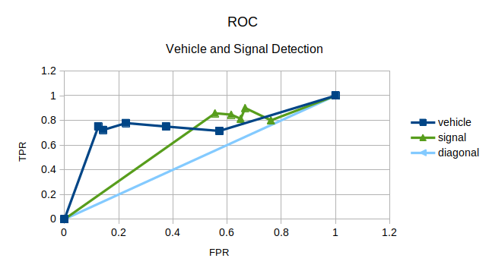
Graph Plotted

Slide 20
Core WorkLoad Management
Jetson Nano
Total Number of Cores - 4

Slide 21
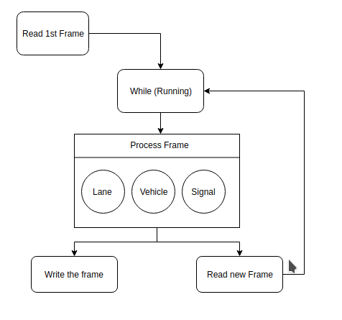
Scheduler Algorithm

Slide 22
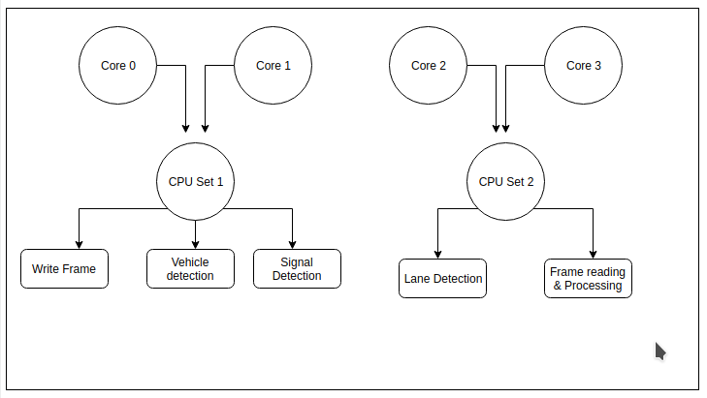
Core Division

Slide 23
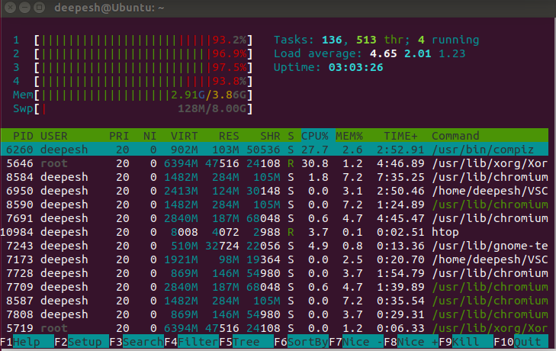
Core Usage

Slide 24
Requirements
There were 3 types of requirements which were suppose to be fulfilled
Minimum
Target
Optimal

Slide 25
Minimum
Modules - Lane Detection, Vehicle Detection, Traffic Signal Detection
Scheduling - Multi-threading with each service as all thread running parallel.
Accuracy
Able to detect the all lane line
Able to detect vehicles around our vehicle
Able to detect all the signals in the view of the camera
FPS - 20 frames per second

Slide 26
Target
Modules - Lane Detection, Vehicle Detection, Traffic Signal Detection, Pedestrian Detection
Scheduling - Multi-threading with full core utilization. Setting cores for threads to achieve real-time processing
Accuracy
Able to detect just the lanes in region of interest
Able to detect vehicles in the region of interest
Able to detect all the signals in region of interest
FPS - 22- 25 frames per second

Slide 27
Optimal
Modules - Lane Detection with Departure Warning , Vehicle Detection with Warning, Traffic Signal Detection, Pedestrian Detection.
Scheduling - Designing a Scheduler for dividing the core WorkLoad and utilizing core to the fullest
Accuracy-
Averaging out multiple lines and just drawing one line per lane
Able to detect vehicles close enough and notify
Able to detect all the signals which are relevant to us.
FPS - 30+ frames per second

Slide 28
References
[1] http://epacis.net/jcis/PDF_JCIS/JCIS11-art.0101.pdf
[2] https://en.wikipedia.org/wiki/Receiver_operating_characteristic

